Slide 1
Computer
Product
Suggestion

Slide 2
Group 13 - Team Member
1
Supervisor: Mr. Kiều Trọng Khánh
2
Phạm Hồng Sang
3
Huỳnh Thanh Việt
4
Trần Tân Lên
5
Hà Chí Danh (dropped out )

Slide 3
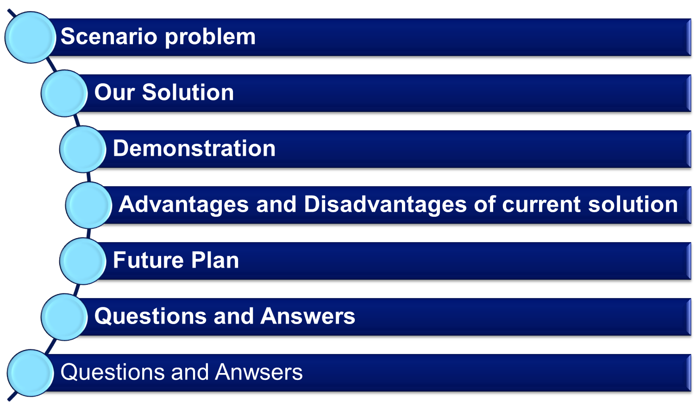
Outline

Slide 4
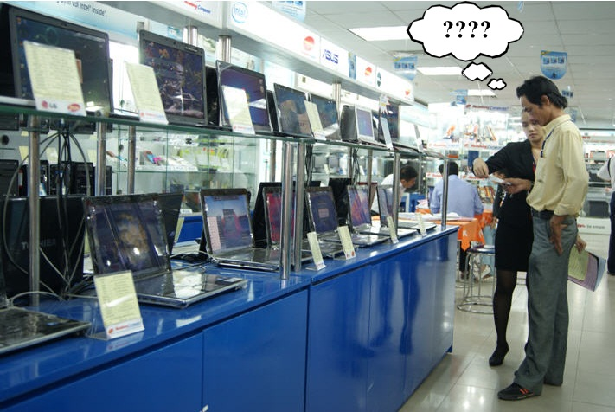
Scenario Problem

Slide 5
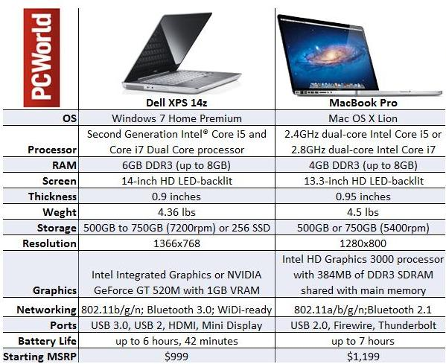
Scenario Problem

Slide 6
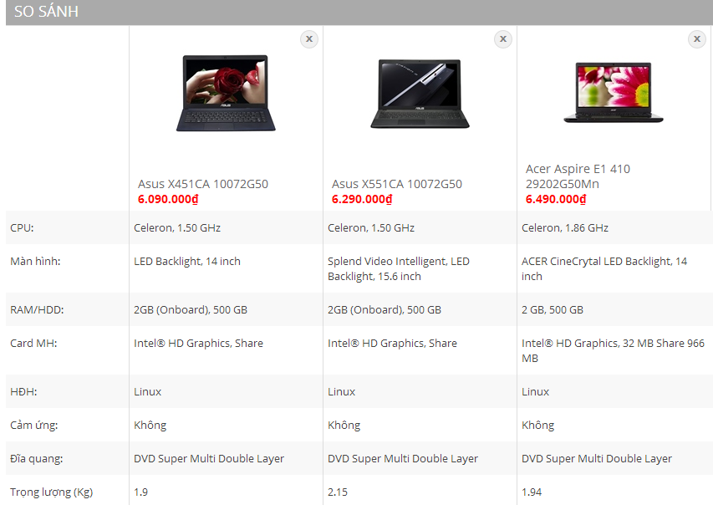
Scenario Problem

Slide 7
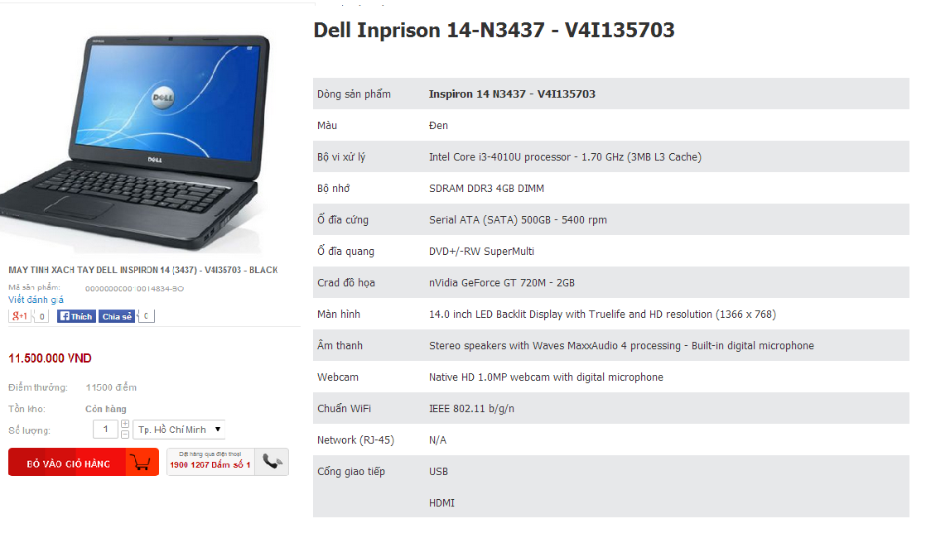
Scenario Problem

Slide 8
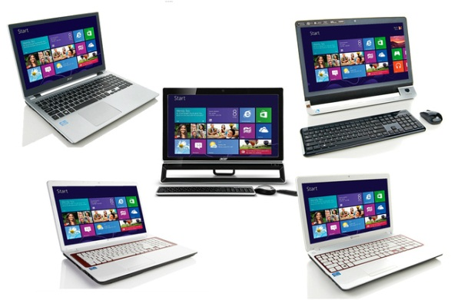
Scenario Problem

Slide 9
Scenario Problem

Slide 10



Our Ideas
Text
Text
Collect Data
Build Data System
Go Online

Slide 11





Our Solution
Add Your Title

Slide 12

Features

Slide 13
Diagram
Title
Add your text
ThemeGallery is a Design Digital Content & Contents mall developed by Guild Design Inc.
ThemeGallery is a Design Digital Content & Contents mall developed by Guild Design Inc.

Slide 14
Cycle Diagram
Add Your Text
Text
Text
Text
Cycle name
Text
Text

Slide 15

Diagram
ThemeGallery is a Design Digital Content & Contents mall developed by Guild Design Inc.
Title
ThemeGallery is a Design Digital Content & Contents mall developed by Guild Design Inc.
Title
ThemeGallery is a Design Digital Content & Contents mall developed by Guild Design Inc.
Title

Slide 16
Diagram
Title
Add your text
Title
Add your text
Title
Add your text
Title
Add your text

Slide 17
Diagram
Text
Text
Concept
Text
Text
Text
Text
Add Your Text

Slide 18
Diagram
Add Your Text
Add Your Text
Add Your Text
Add Your Text
Add Your Text
Add Your Text
Add Your Text
Add Your Text

Slide 19
Diagram
Add Your Text
Add Your Title
Add Your Text
Add Your Text

Slide 20
Diagram
Add Your Text
Add Your Text
Add Your Text
Title
Add Your Text
Add Your Text
Add Your Text

Slide 21
Diagram
1
2
3
ThemeGallery is a Design Digital Content & Contents mall developed by Guild Design Inc.
ThemeGallery is a Design Digital Content & Contents mall developed by Guild Design Inc.
ThemeGallery is a Design Digital Content & Contents mall developed by Guild Design Inc.

Slide 22
Diagram
2001
2002
2003
2004
Your Text
Your Text
Your Text
Your Text
Your Text
Your Text
Your Text
Your Text

Slide 23
Progress Diagram
Phase 1
Phase 2
Phase 3

Slide 24
3-D Pie Chart
Text2
Text3
Text1
Text4
Text6
Text5

Slide 25
Thank You !
www.themegallery.com

